Slide 1
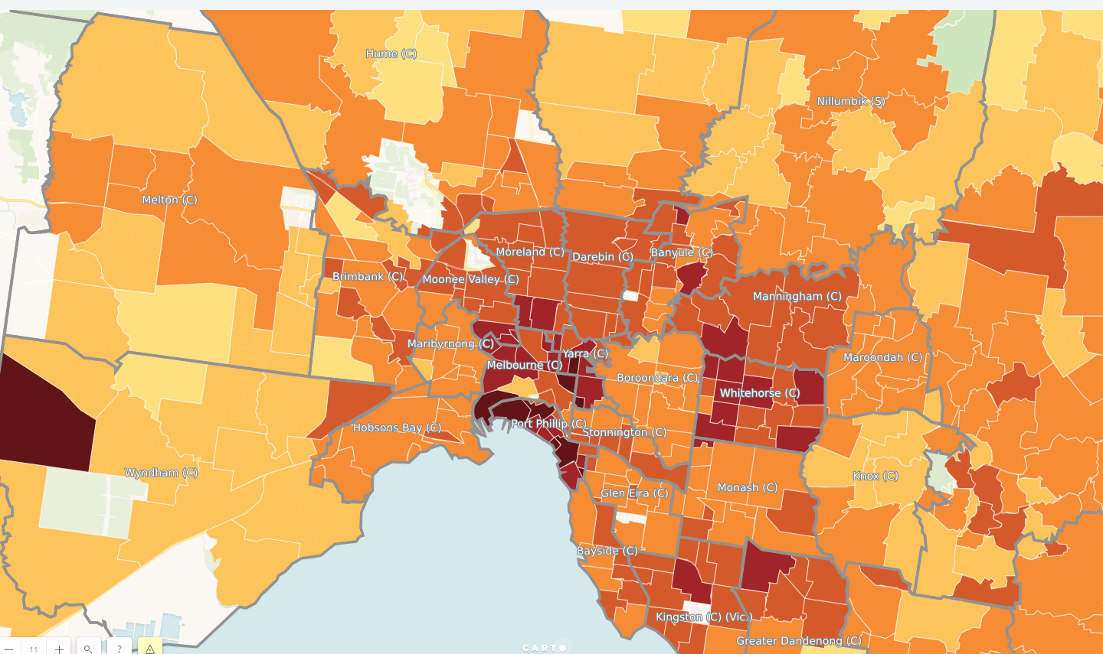
>250 days
200-250 days
150-200 days
100-150 days
50-100 days
< 50 days

